Slide 1
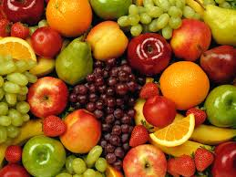
ENS Primary School Healthy Eating Day
Tuesday 26th March 2013
We are so excited to be having a healthy eating day at school. Each Grade has a different color, the challenge is to dress up and bring in healthy food the same color.
Grade 1 Red
Grade 2 Green
Grade 3 Yellow
Grade 4 Orange

